Slide 1
Assignment 2 - Implementation of Recurrent Perceptron​
Swapnil Bhattacharyya,23M0753
Manishit Kundu,23M2163
Ujjwal Sharma,23M0837 Date-31st March,2024

Slide 2
Problem Statement
Input: POS-tagged input tokens, converted into a 9-D vector of the form: [^, previous_word, current_word]
Output: Noun chunk labels (0/1) on tokens. The beginning of the chunk will be labeled 1 and the rest of the words in the chunk will be labeled 0. All other words are labeled 1.

Slide 3



Implementation Details
Input: 9-dimensional vector + 1 scalar (feedback)
Output: 1 single scalar output
Activation function: Sigmoid function
Loss function = Mean Squared Error
BPTT Gradient rule:
We have used Truncated BPTT, where we limit the number of steps we BPTT through.

Slide 4
Overall performance
Test Set Accuracy | Total
In percentage | 84.34
Fold | 5-fold validation Accuracy
1 | 86.62
2 | 86.75
3 | 86.98
4 | 87.28
5 | 86.80
Average | 86.89

Slide 5
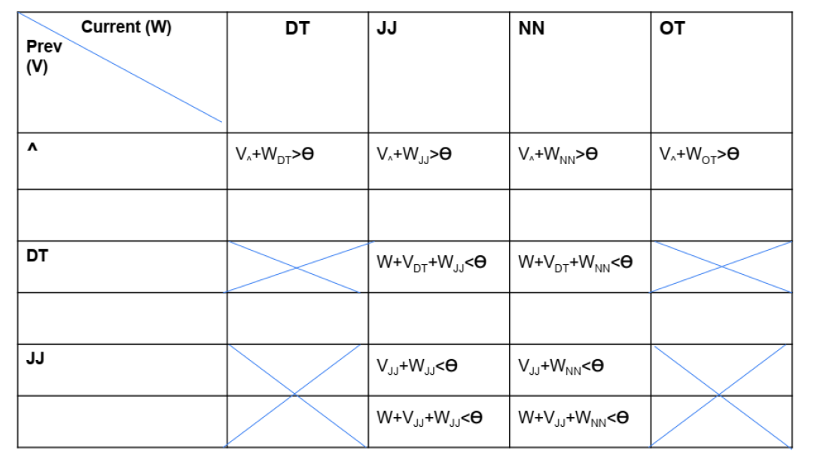
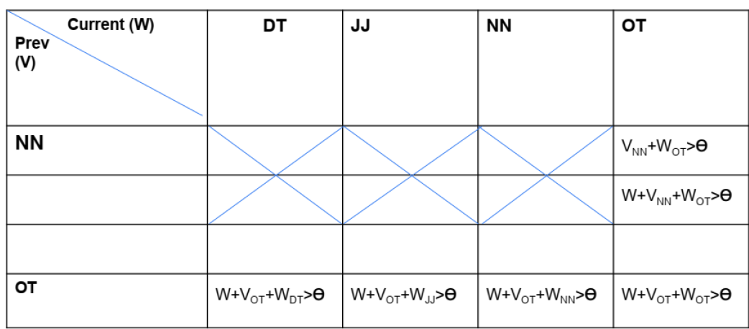
Language constraint table(1/3)
Show that the inequalities given in the problem statement hold for the perceptron to satisfy the language constraints

Slide 6
Language constraint table(2/3)
Our best set of weights and bias are as follows:
[V^ = 6.00525099, VNN = -0.25138642, VDT = -2.41375883, VJJ = -1.35789249, VOT = 2.7089287, WNN = -2.79950985, WDT = 1.83492126, WJJ = -2.40748616, WOT = 1.8481467, W = 0.23551078
b = -0.5396426]
We use these to check whether the language constraints are satisfied.

Slide 7
Language constraint table(3/3)
Current(W) Previous(V) | DT | JJ | NN | OT
^ | 6.00 + 1.83 > -0.54 | 6.00 - 2.4 > -0.54 | 6.00 - 2.8 > -0.54 | 6.00 + 1.84 > -0.54
DT |  | 0.23 - 2.41 - 2.4 < -0.54 | 0.23 - 2.41 - 2.8 < -0.54
JJ |  | -1.36 - 2.4 < -0.54 0.23 -1.36 - 2.4 < -0.54 | -1.36 - 2.8 < -0.54 0.23 -1.36 - 2.8 < -0.54
NN |  |  |  | -0.25 + 1.84 > -0.54 0.23 - 0.25 + 1.84 > -0.54
OT | 0.23 + 2.70 + 1.83 >-0.54 | 0.23 + 2.70 - 2.4 > -0.54 | 0.23 + 2.70 - 2.8 > -0.54 | 0.23 + 2.70 + 1.84 > -0.54

Slide 8
Error Analysis
Compound nouns:
Example: [Donald, Trump, was, the, president, of, the, United, States, of, America] POS Tags: [1, 1, 4, 2, 1, 4, 2, 1, 1, 4, 1] Target: [1, 0, 1, 1, 0, 1, 1, 0, 0, 0, 0] Prediction: [1, 0, 1, 1, 0, 1, 1, 0, 0, 1, 1]
Unexpected Noun Chunk Pattern: Example: ['It', 'was', 'the', 'second', 'costly', 'blunder', 'by', 'Syria', 'in', 'four', 'minutes', '.'] POS Tags: [4, 4, 2, 3, 3, 1, 4, 1, 4, 4, 1, 4] Target: [1, 1, 1, 0, 0, 0, 1, 1, 1, 1, 0, 1] Prediction: [1, 1, 1, 0, 0, 0, 1, 1, 1, 1, 1, 1] Example: ['China', '0', 'Uzbekistan', '2', '(', 'halftime', '0-0', ')'] POS Tags: [1, 4, 1, 4, 4, 1, 4, 4] Target: [1, 0, 0, 0, 0, 0, 0, 1] Prediction: [1, 1, 1, 1, 1, 1, 1, 1]
We expect these errors could reduce if we adopt a larger n-gram encoding as well as use better POS tagging (i.e. split the OT tag further into other tags).

Slide 9
Learnings
Understanding RNNs
Sequential Data Handling
Backpropagation Through Time (BPTT)
Gradient Issues
Hyperparameter Tuning
Debugging Sequential Models
Memory and State Management

Slide 10
Evaluation Scheme
Correct implementation of BPTT from scratch: 10 marks (show the code parts that implement weight change rules)
Overall Performance: accuracy >=90: 10 marks; 80-89: 9; 70-79: 8; 60-69: 7; 50-59: 40-49: 5; 30-39: 4. And so on
Error Analysis: 10
Inequality Table: 10
Demo: 10

Slide 11
Project: Contrastive-Learning-aided MT
emb
Loss 1 I like toys.
English sentence: I like toys.
Eng2Eng Autoencoder
Contrastive Loss (Similarity based)
Loss 2
emb
Hindi Sentence:
मुझे खिलौने पसंद हैं
Hindi2Hindi Autoencoder
Loss 3
मुझे खिलौने पसंद हैं

